Slide 1
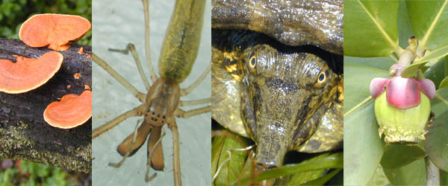
GENERAL BIOLOGY fdn 1203
Dr. Theja Abayarathna
Department of Biology
Faculty of Applied Sciences
Rajarata University of Sri Lanka

Slide 2
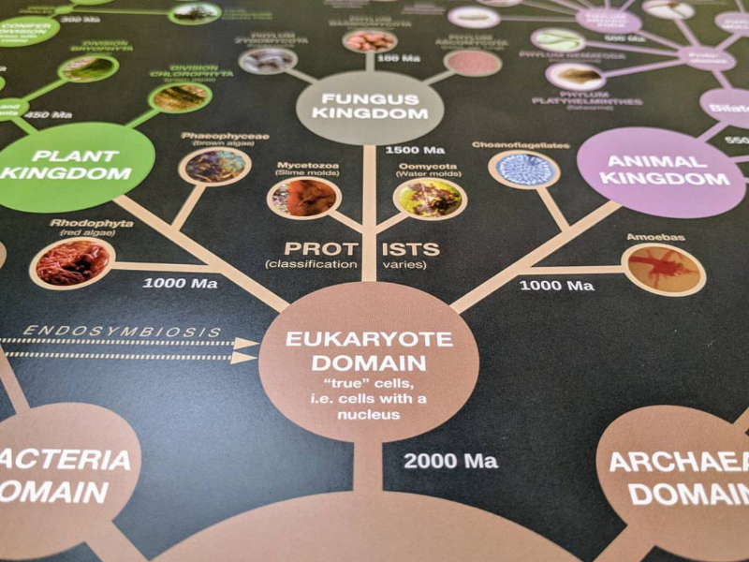
Classification of life
Week 6

Slide 3
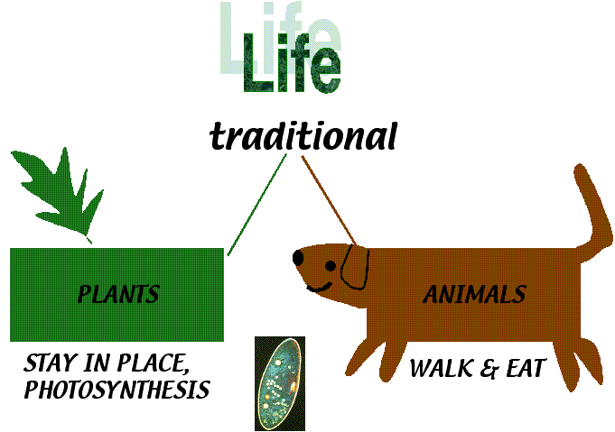
In early history people knew only plants and animals
Linnaeus developed his system of classification, there were only two kingdoms, Plants and Animals.

Slide 4
The invention of the microscope led to the discovery of new organisms and the identification of differences in cells.
So, the two-kingdom system was no longer useful.
Today the system of classification includes six kingdoms.

Slide 5
The six kingdoms of life
1. Archaebacteria
2. Eubacteria (bacteria and cyanobacteria / blue green algae)
3. Protista (algae and slime moulds)
4. Fungi (mushroom, yeasts, moulds)
5. Plantae (plants)
6. Animalia (animals)

Slide 6
In addition to this, there are ‘viruses’.
These are sub-microscopic agents that can be seen only through the electron microscope.
They are unable to grow and reproduce out side living cells.
They share both living and non living characteristics.

Slide 7
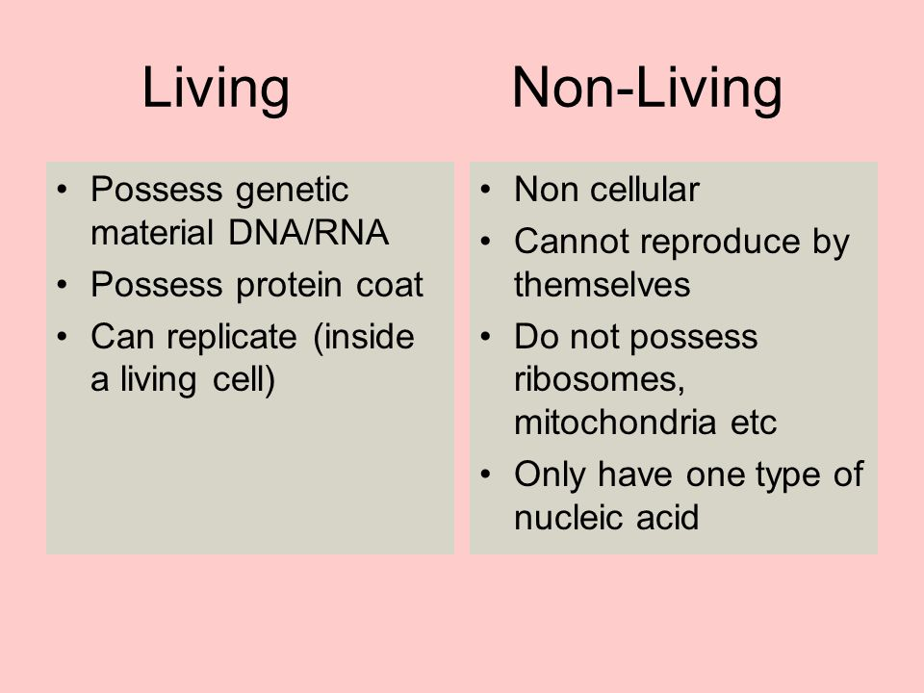
Living and non living characteristics of Viruses

Slide 8
Kingdom 1. Archaebacteria
These are a diverse group of bacteria
Archaebacteria are different from Eubacteria, from the places where they live.
They live in extreme conditions which are not suitable for other normal life forms
There are three major known groups of Archaebacteria:

Slide 9
1.Methanogens
2. Halophiles
3. Thermophiles

Slide 10
1. Methanogens
They live in oxygen less environments
They are found in sewage treatment plants, bogs, and the intestinal tracts of some animals.

Slide 11
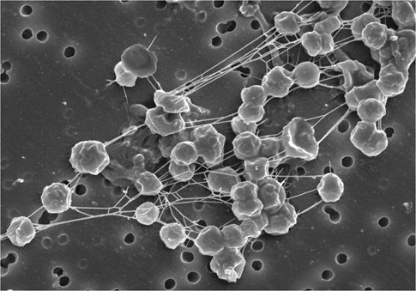
Methanogens

Slide 12
2. Halophiles
Are bacteria that thrive in high salt concentrations such as sea water
3. Thermophiles
Are the heat-loving bacteria found in hot water springs.

Slide 13
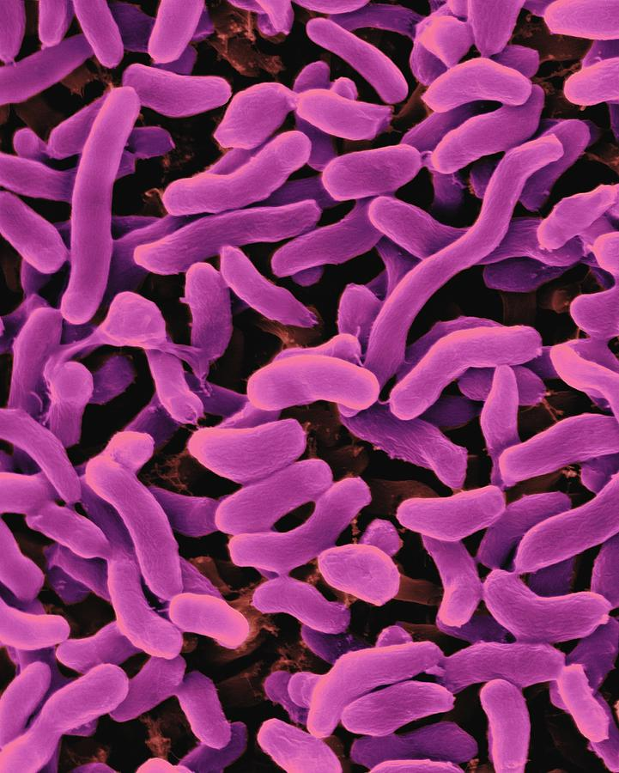
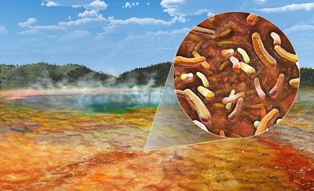
Thermophiles
Halophiles

Slide 14
Kingdom 2. Eubacteria
Includes Bacteria and Cyanobacteria
Bacteria
Tiny minute organisms that can not be seen with the naked eye

Slide 15
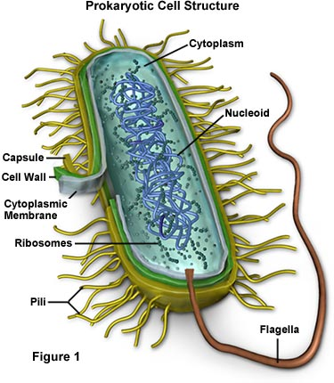

Slide 16
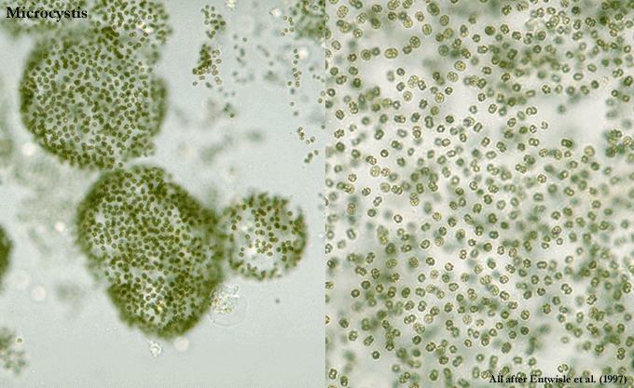
Cyanobacteria
These are prokaryotic, photosynthetic (can make their own food) simple life forms
Ex. Microcystis

